Slide 1


Data
Analysis
Portfolio Project Challenge
Insights on Lung Cancer Data
Presented by : Arundhuti Roy
Date of Submission : 21/02/25
Tools Used : Microsoft SQL Server & Power BI

Slide 2
PROBLEM STATEMENT :
This project analyzes the risk factors causing lung cancer by utilizing the provided dataset on lung cancer patients. The demographic along with the medical & lifestyle factors can be used for an early detection & diagnosis of lung cancer, thus helping in improving the survival rate through customizing the treatment plan according to the patient’s requirement, with the help of healthcare analytics.
OBJECTIVE :
This dataset can be used to assess the impact the impact of different factors on the outcome of different patients depending on their requirements & to treat the cancer in an effective manner. This dataset can also be used for creating Power BI reports to visualize the different metrics in a clear & prominent manner.

Slide 3
DATASET OVERVIEW :
Number of Records : 220632
Number of Columns : 24 (which includes demographic, medical & other factors)
DATASET PREPROCESSING :
Cells with None Values :
Treatment Type : 213968 cells contained value “None”, they were replaced with “No Treatment” to reflect that there wasn’t any treatment provided to those people.
Cancer Stage : 211671 cells contained value “None”, they were replaced with “Early Stage” to reflect that their cancer stage is either not detected or non-cancerous.

Slide 4
SQL QUERIES ↪

Slide 5

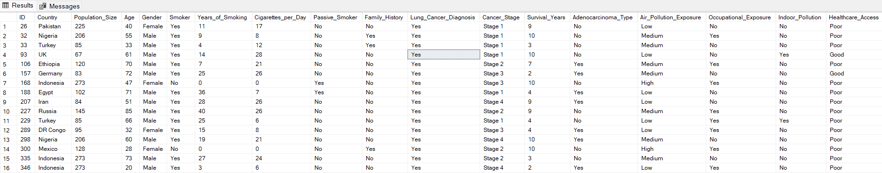
BASIC LEVEL
Retrieve all records for individuals diagnosed with lung cancer.
and more….

Slide 6


2. Count the number of smokers and non-smokers.

Slide 7

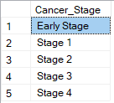
3. List all unique cancer stages present in the dataset.

Slide 8


4. Retrieve the average number of cigarettes smoked per day by smokers.

Slide 9


5. Count the number of people exposed to high air pollution.

Slide 10

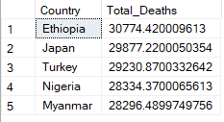
6. Find the top 5 countries with the highest lung cancer deaths.

Slide 11


7. Count the number of people diagnosed with lung cancer by gender.

Slide 12

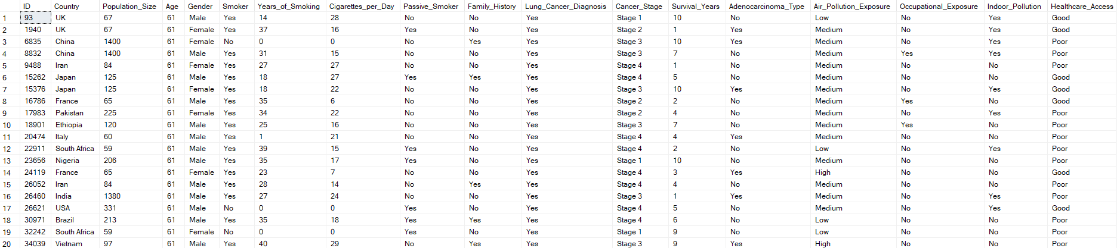
8. Retrieve records of individuals older than 60 who are diagnosed with lung cancer.
and more….

Slide 13

2. INTERMEDIATE LEVEL
Find the percentage of smokers who developed lung cancer.

Slide 14

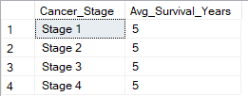
2. Calculate the average survival years based on cancer stages.

Slide 15


3. Count the number of lung cancer patients based on passive smoking.

Slide 16

4. Find the country with the highest lung cancer prevalence rate.

Slide 17
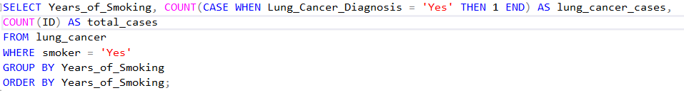
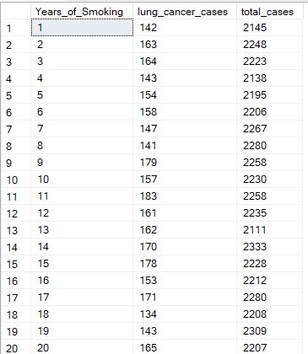
5. Identify the smoking years' impact on lung cancer.

Slide 18
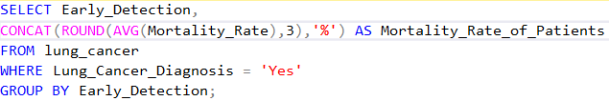

6. Determine the mortality rate for patients with and without early detection.

Slide 19


7. Group the lung cancer prevalence rate by developed vs. developing countries.

Slide 20
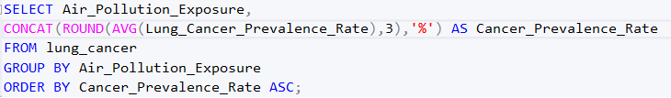
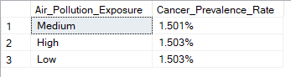
3. ADVANCED LEVEL
Identify the correlation between lung cancer prevalence and air pollution levels.

Slide 21
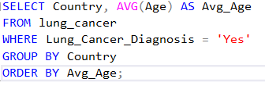
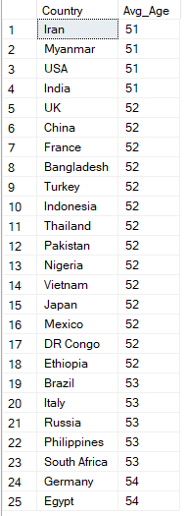
2. Find the average age of lung cancer patients for each country.

Slide 22
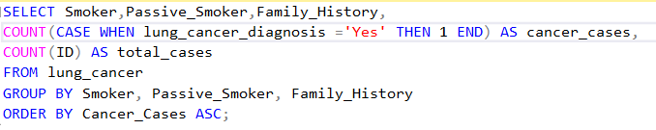
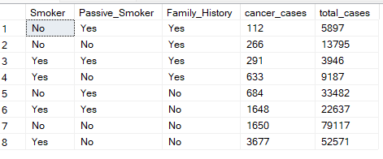
3. Calculate the risk factor of lung cancer by smoker status, passive smoking, and family history.

Slide 23
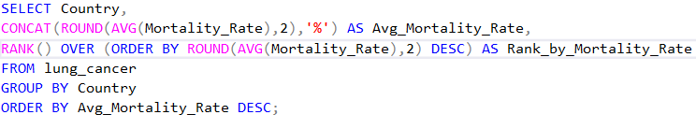
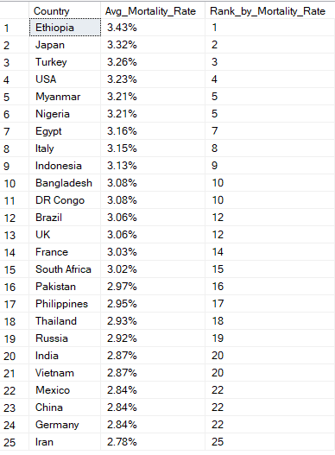
4. Rank countries based on their mortality rate.

Slide 24
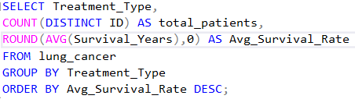
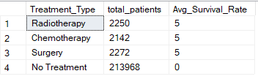
5. Determine if treatment type has a significant impact on survival years.

Slide 25
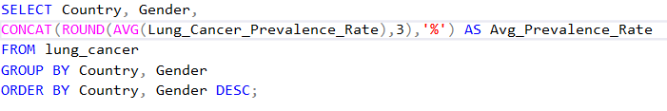
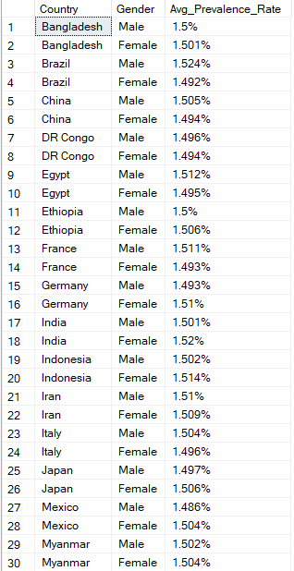
6. Compare lung cancer prevalence in men vs. women across countries.

Slide 26
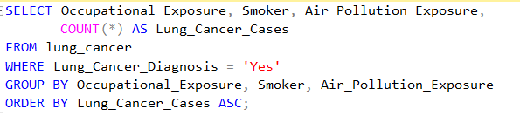
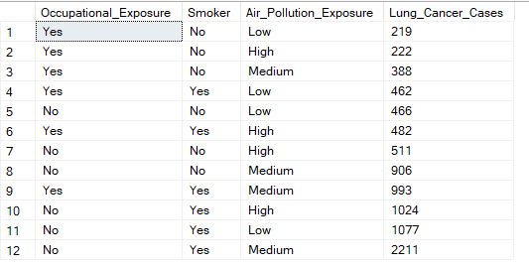
7. Find how occupational exposure, smoking, and air pollution collectively impact lung cancer rates.

Slide 27


8. Analyze the impact of early detection on survival years.

Slide 28
DATA VISUALIZATION & REPORT

Slide 29
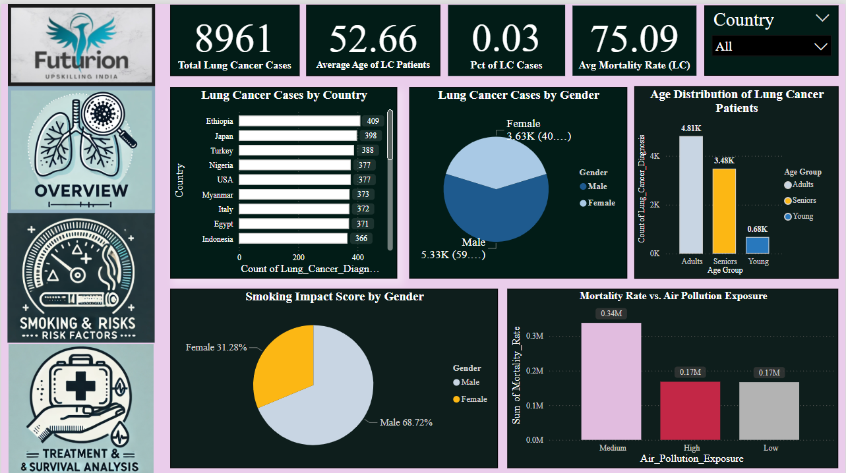
1. LUNG CANCER OVERVIEW

Slide 30
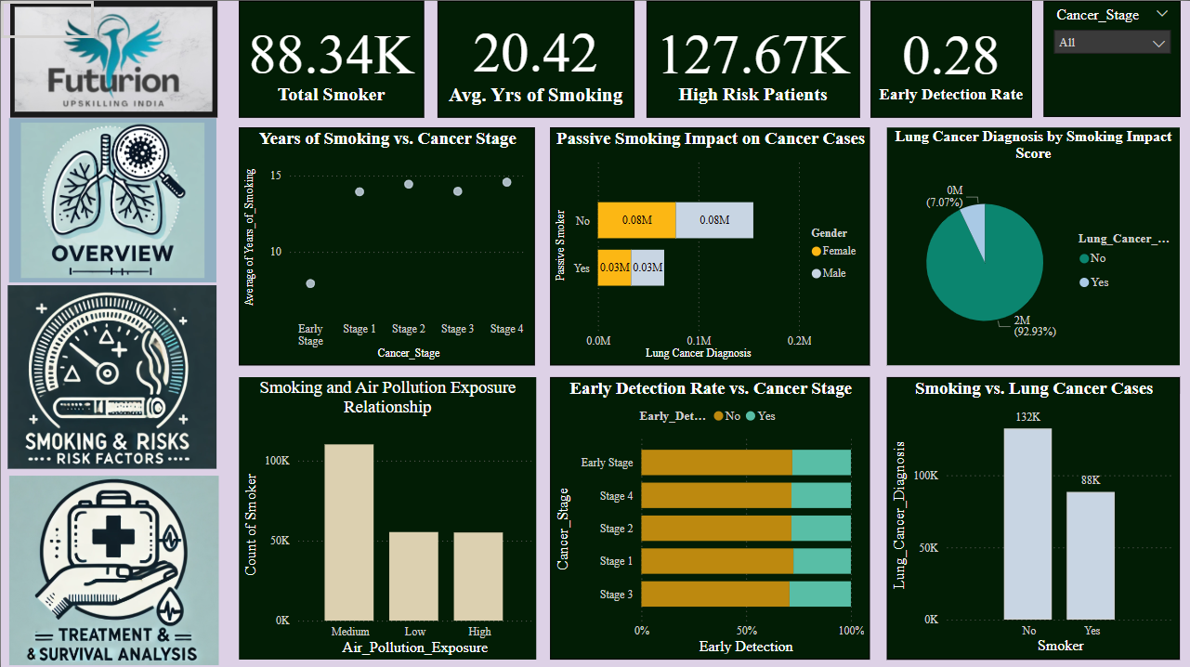
2. SMOKING & RISK FACTORS

Slide 31
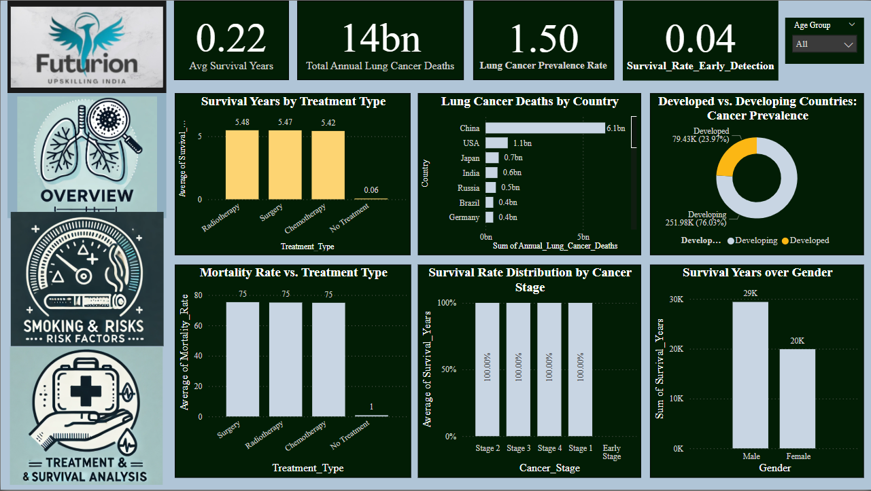
3. TREATMENT & SURVIVAL ANALYSIS

Slide 32
Key Insights ::
The average count of cigarettes smoked per day being 17, smoking is thus the biggest threat to the health of a person, becoming the highest risk factor.
Due to the harmful effect of smoking, 7.07% of the total smokers have been diagnosed with lung cancer, among which around 40% are female with around 59% being male population.
Ethiopia, Japan, Turkey, Nigeria & USA are the top 5 countries with largest number of lung cancer cases.
It can also be noticed that the non-passive smokers are also highly diagnosed with lung cancer, the number of patients being more than compared to passive smokers.
China records the highest lung cancer death count compared to the other countries.

Slide 33


